Slide 1
CSCI 2100 Project 2-3-4 Tree
By
Lai Tai Yi
Lam Kam Ho
Lui Lok Hang Kenneth

Slide 2
What is 2-3-4 Tree
Basic Properties:
It is a Multiway Tree.
Every Data is unique.
Each node contains:
Up to 3 Data items
2 ~ 4 Children
Let No. of Data Items ->D, Link/Children->L
L=N+1

Slide 3
What is 2-3-4 Tree
Basic Properties:
Suppose the storage of 3 items in a node is implemented by Array item[]
Data in item[0] is the smallest, Data in item[1] is medium, Data in item[2] is the largest
Suppose the order of children is from left to right.
Values of:
Data(s) in 1st child is smaller than the item[0].
Data(s) in 2nd child is between item[0] and item[1].
Data(s) in 3rd child is between item[1] and item[2].
Data(s) in 4th child is larger than the item[2].

Slide 4
What is 2-3-4 Tree
Special Properties:
A node has at least has 2 Children, unless it is a leaf.
Node splitting may occur during insertion.
It is rearrangement that keeps the tree balanced.
It is a self-balanced Tree.
EVERY leaves are always the same level.
The Middle item of Node is always near to the value of the medium of its subtree.
Why? We ‘ll come back to these issues in the Insertion part.

Slide 5
Search
Similar to search in binary tree
start at the root
unless the search key is found there, select the link that leads to the subtree with the appropriate range of values.
Example with diagram is illustrated in next page

Slide 6
Insertion
Rules:
New data items are always inserted in leaves/Bottom Level
And there are few Cases:
Case1:no full nodes are encountered during the search
When the right leaf node is reached, the new data item is inserted into it.
moving one or two other items in a node may occur for keeping correct order after the new item is inserted.
example with diagram is in next page

Slide 7
Insertion
Case 2:full node(Not Root) is met when diving(searching) down to insertion point
‘Node Split’ is needed
Nodes are split on the way down to the insertion point.(top-down 2-3-4 tree)
A new empty node is created which is a sibling of the “full node” and is placed to its right.
Let data items in the “full node” be item[0],[1],[2]
item[2] is moved into the new node.
Item[1] is moved into the parent of the “full node”.
Item[0] remains where it is.
The connection are cut rightmost two children of “full node” are cut and connected to the new node.
When the right leaf node is reached, the new data item is inserted into it.
Example with diagram is illustrated in next page

Slide 8
Insertion
Case 3:full node(Root) is when diving(searching) down to insertion point
‘Node Split’ is needed
A new root is created and becomes the parent of the old root.
A second new node is created and becomes a sibling of the old root.
Let data items in the “old root” be item[0],[1],[2]
item[2] is moved into the new node.
Item[1] is moved into the new root.
Item[0] remains where it is.
The connection of rightmost two children of “full node” are cut and connected to the new root.
When the right leaf node is reached, the new data item is inserted into it.
Example with diagram is illustrated in next page

Slide 9
Insertion Discussion of Insertion & Node Split
A node has at least has 2 Children, unless it is a leaf.
Explanation:
Considering the insertion point in the Root/Node is not full. Then the new item must be inserted into the free space of node.
When full node is met, the middle of “Node split” is moved to the upper level node and the upper level node must connected to the two spitted node(part) from the old node.

Slide 10
Insertion Discussion of Insertion & Node Split
2. 2-3-4 Tree is a self-balanced Tree.
Explanation:
It doesn’t like Binary Search Tree. When item is inserting, create a new level for insertion which may leads to data accumulated in one subtree and the height of each leaf is not the same.
The key concept of 2-3-4 tree insertion is “node spilt”.
It moves the middle item of a full node into the (new for root )parent for making space for the new item.
It is a concept that push a new subtree of the full node‘s parent out which is same level with the full node.
It ensures the tree grow “horizontally”.
Therefore, 2-3-4 Tree is a self-balanced Tree.

Slide 11
Deletion
Rule:
The item to be deleted must be a leaf node
If not, it is swapped with a preceding element in in-order traversal (which must be in a bottom node) and that element removed instead.
Transforming a 4-link-node(3 items) into a 3-link-node/ a 3-link-node(2 items) into a 2-link-node(1 items)
Deletion of 2-link-node needs special handling

Slide 12
Deletion
Deleting item in 1-item node cause a node with no item( Called: Underflow).
Transfer is needed.
An item in parent node is moved into the node where the item is being removed.
The new free space in the parent node is replaced with an item from a sibling node.
When the siblings are also 1-item node
Underflow still occurs
Pulling item from the parent node
Two sibling nodes are fused together
Move the item in the larger sibling node to the parent node
Delete the item
When the parent are also 1-item node
Using “Transfer” Again(borrow item from its parent)
As deletions and replacements are being made, This may cause different parent node to sustain underflow which is called Underflow Cascading.

Slide 13
Height Analysis
Let height be h
Best Case:
N=no. of Node= 4^h-1≈4^h (All nodes with 4 children)
log₄(4^h)=h
log₄(N)=h
(0.5)log₂(N)=h
Worse Case:
All nodes with exact 2 children, which is similar to balanced binary tree(E.G. AVL/Red-Black Tree)
log₂(N)=h

Slide 14
Time Complexity of Searching
Proportional to the Height of Tree, log₄(N) /log₂(N)
Proportional to the Number of items in each Node
suppose all nodes are full, which contains 3 items
Search time proportional to 3* log₄(N)/3*log₂(N)
Suppose not all nodes are full, which contains 2 items in average
Search time proportional to 2* log₄(N)/2*log₂(N)
Therefore, time complexity for Search = O(logN)
Special Case: Searching the Minimum
Since the Lowest and the most Left Leaf is always the same node
By using a pointer to point the first node from start to end
Searching the Minimum is constant time O(1).

Slide 15
Time Complexity of Delete
Deletion in a 2-3-4 tree is O(log n), assuming transfer and fusion run in constant time ( O(1) ).

Slide 16
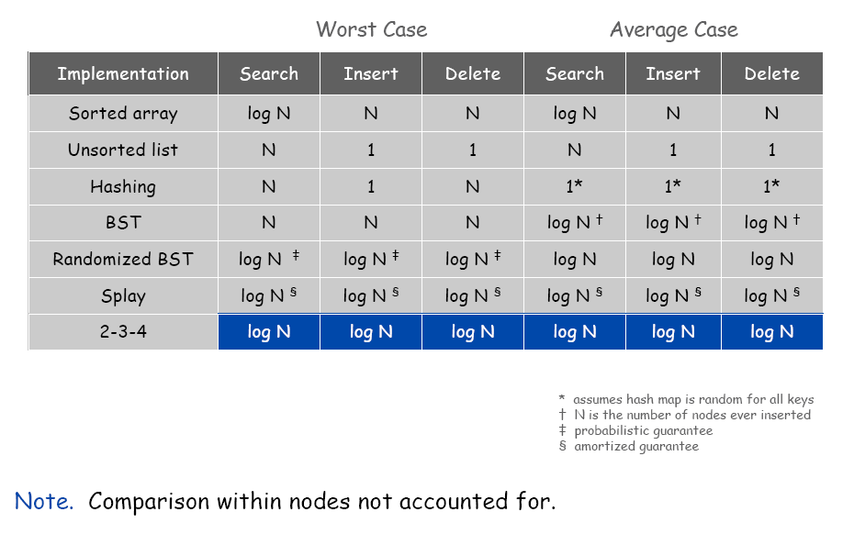
Summary and Comparison of Time Complexity

